Slide 1
NBA Player Recommender
Created by Paolo Natividad

Slide 2

Scenario
Imagine being in a fantasy basketball league with your colleagues
Your team is looking solid. You have 2 more picks with your draft
But wait!
You have a Joel Embiid sized hole in your team that you need to fill!
What do you do?

Slide 3
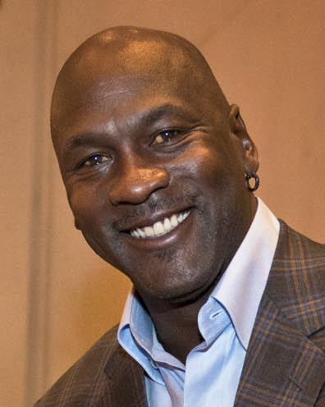
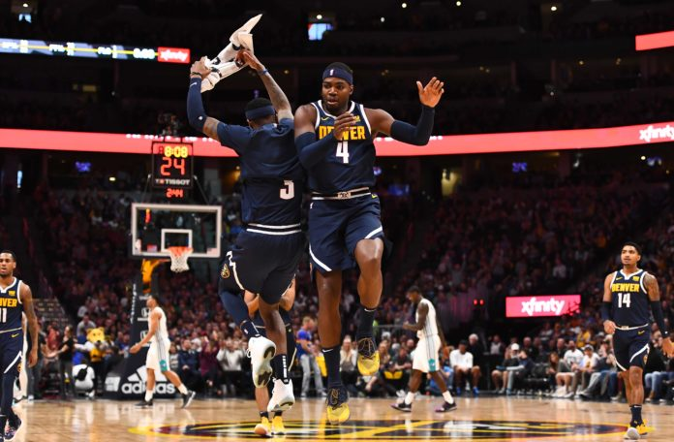
Enter the Recommender
With my recommender system you can find your replacement easily.
That Joel Embiid sized hole is now filled with with a Paul Millsap sized solution

Slide 4

The Process: Collecting the Data
Data was scraped from Basketball Reference
First Scrape:
Teams
Second Scrape:
Players per team
Third Scrape
Last 3 years stats and career stats per player
Notes:
Used beautiful soup
Each time i scraped I saved to a csv so I do not need to rescrape every time I wanted the information.
First scrape got each team and the slug of the team url. The scrape would look at the first table in the team index and go through each of the elements that are hyper links.
Second scrape went to the team page of each page, went to the upcoming season roster, and then scraped their rosters. It got the name of the players, their years of experience, the url slugs for the player, their position, and their team.
Third scrape went to the individual player page for each player. I scraped their last 3 seasons and their career stats. I had some if statements to deal with if they had less than 3 seasons under their belt.
This third scrape basically scraped every single box score stat. Field goals, shooting percentages, assists, boards, etc.

Slide 5
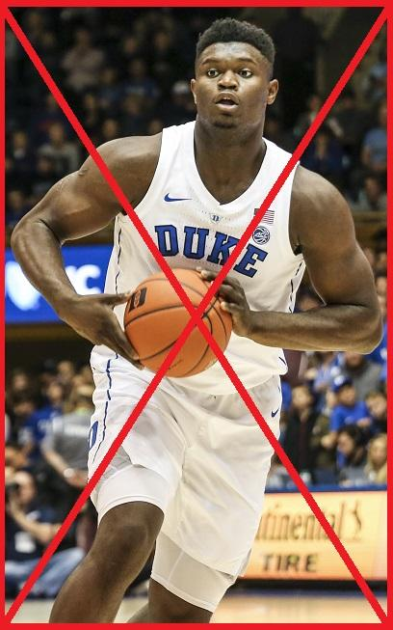
Preprocessing and Troubleshooting
Preprocessing
No Rookies
Troubleshooting
Getting to the rosters of the Brooklyn Nets, Charlotte Hornets, New Orleans Pelicans
Difficulties scraping data for 350+ people
Null Values
Player Positions
Notes:
No rookies. I did not want to deal with predicting a rookies success from their prior stats. If college stats were predictive then you would never have busts. I considered this way out of my jurisdiction
The number of players I had to scrape was cut down by 50
Troubleshooting
Made a catch for my second scrape (team scrape) that would list the team that causes the error.
In my third set of scrapes i needed a catch incase my connection times out. I had it print the index so i can determine where do I have to rescrape.
Had some null values with categories like free throw attempts from players that have very few minutes. Input 0’s in them.
In bball reference people could be listed under multiple positions like G-F, F-G or F-C,C-F. I took the first instance letter of their position to be their primary position.

Slide 6
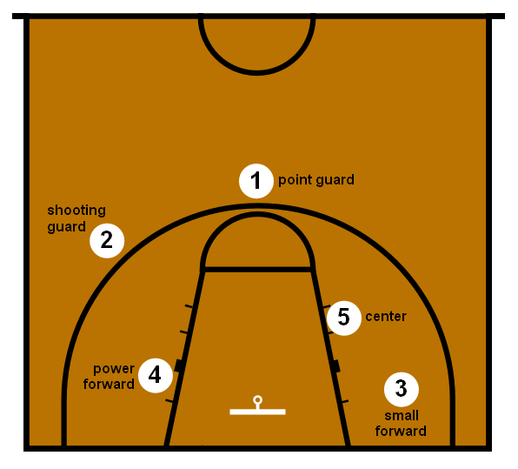
The Process: The Recommender
Had to create an aggregate dataset from the 3 year scrape
Positions to Numeric
Two types of recommenders
Unscaled
Scaled
Combining Career and Aggregate
Notes:
Aggregate dataframe
Going from a 900+ rows 370 rows.
Needed to match the size of the career dataframe
Position to numeric
In order to calculate similarities I needed to convert everything to numeric
I converted guards to 1
Forwards to 3
And centers to 5
2 types:
Unscaled I didnt enjoy the suggestions.
Scaled passed the eye test better
Career and aggregate:
I wanted career because this is the players overall consistency
I wanted aggregate because people can get better recently or be on the start of their decline. A player who has been in the league for 8 years definitely does not play the same as they did their 2nd year.
Career had some cosine similarities above 1. Thats okay because it means they people are very unsimilar.
Had to determine how much weight i wanted to give each set. Gave career 0.2 and aggregate 0.8.
Combining the dataframes gave the unintended side effect of having similarly aged players be recommended more (due to the number of games played). I thought it was dope so I kept it.

Slide 7
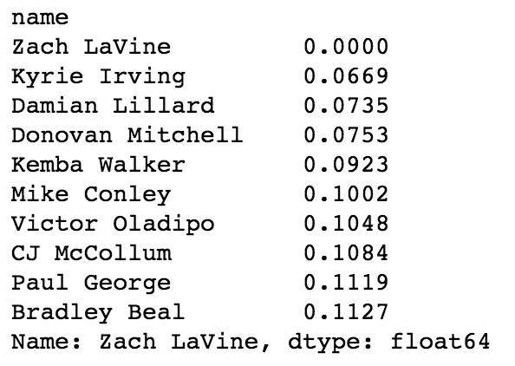
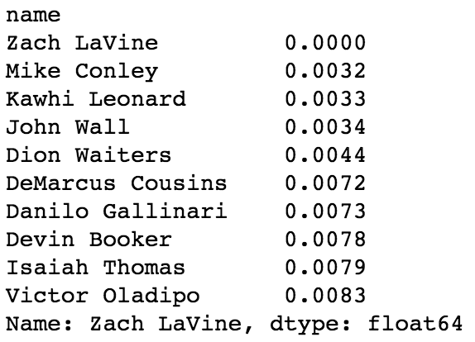
Scaled
Unscaled
Notes:
Unscaled kinda just picked those who stuff the box.

Slide 8
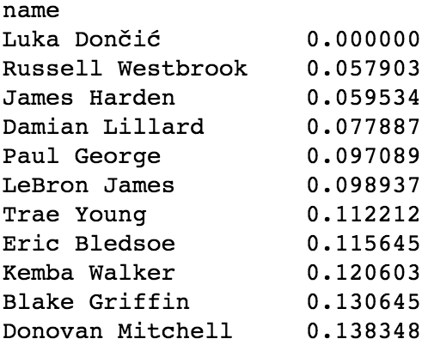
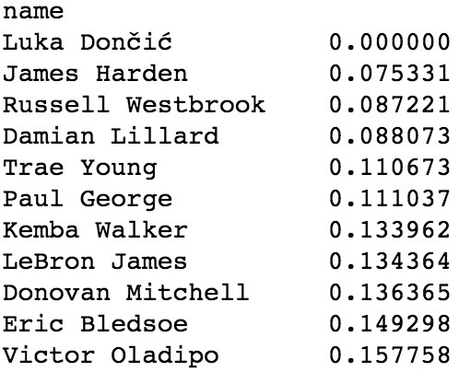
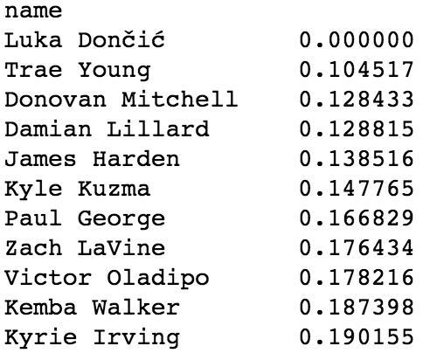
3-Year Agg
Master
Career
Notes:
Career skews young

Slide 9

The Process: The Script
Needed Functionality for Fantasy
Drop players
Making menus
Notes:
Needed to make a search. Make menus to search and drop. Needed to make a function to add someone back in if they were dropped accidentally

Slide 10
Demonstration

Slide 11
Fivethirtyeight
Lonzo Ball
3 Matches on 538: Marcus Smart, Elfrid Payton, D’ Angelo Russell
Marcus Smart: Rank 1 on 538, Rank 6 on Recommender
Elfrid Payton: Rank 2 on 538, Rank 5 on Recommender
D’Angelo Russell: Rank 8 on 538, Rank 9 on Recommender
Joel Embiid
1 Match. Demarcus Cousins
Demarcus Cousins: Rank 1 on 538, Rank 1 on Recommender

Slide 12
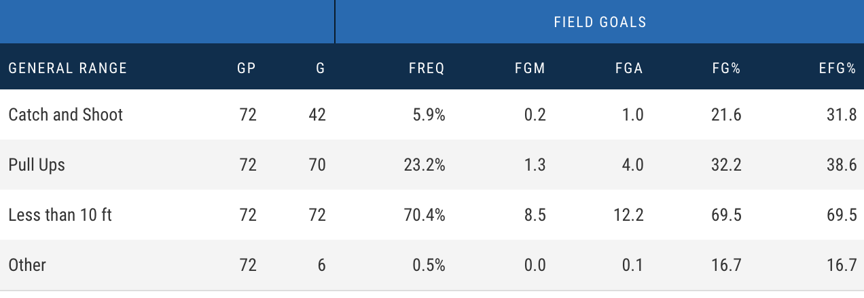
Next Steps
Implement Rookies
Use Advanced Stats

Slide 13

Acknowledgements
Thanks to General Assembly DSI-8 for teaching me these concepts
Thanks to BasketballReference for allowing me to scrape their data
Thank you Russell Westbrook for your contributions to the OKC Thunder
Thank you for your interest

Slide 14
Questions?

